Slide 1
Chapter 10
Trees

Slide 2
Objectives
10.1- Introduction to Trees
10.2- Applications of Trees
10.3- Tree Traversal

Slide 3
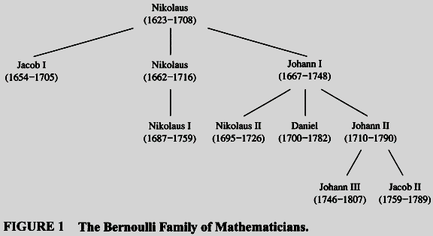
10.1- Introduction to Trees

Slide 4
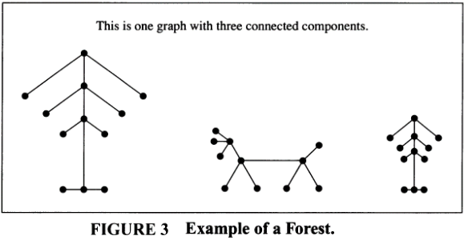
Introduction to Trees…

Slide 5
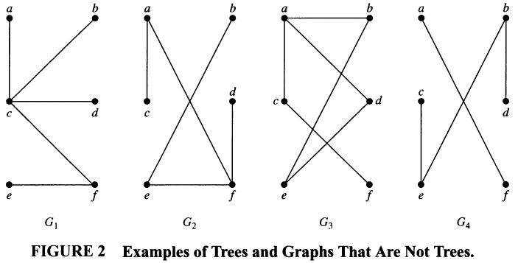
Introduction to Trees
circuit
disconnected

Slide 6


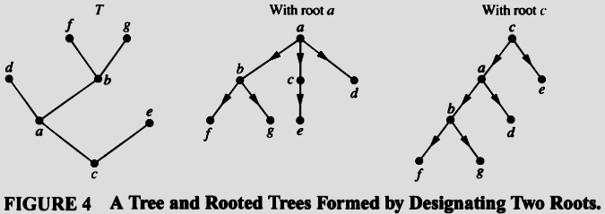
Introduction to Trees…
Proof: page 684

Slide 7
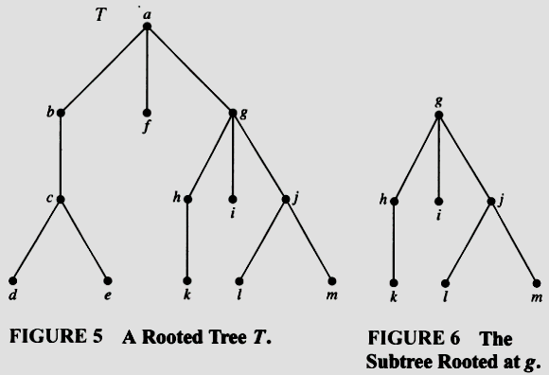
Introduction to Trees…
Some terminologies:
Subtree
Root node (vertex)
Internal node
Leaf
Parent
Child
Siblings
Descendants
Ancestors

Slide 8
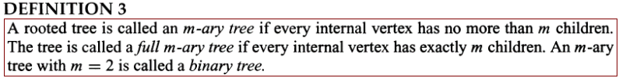
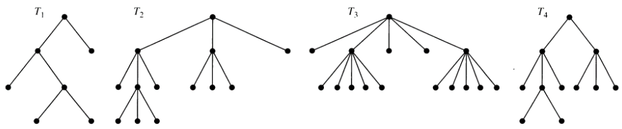
Introduction to Trees…
Full
Binary
Full
Ternary
Full
5-ary
3-ary
Some terminologies on binary tree:
Left child, right child, left subtree, right subtree

Slide 9
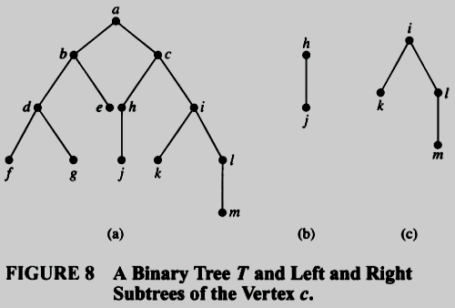
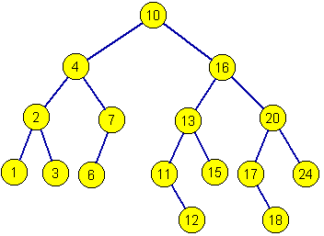
Introduction to Trees…
Ordered rooted tree

Slide 10
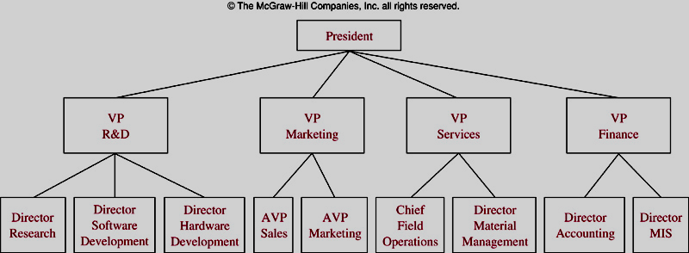
Some Tree Models
A Organizational Tree

Slide 11
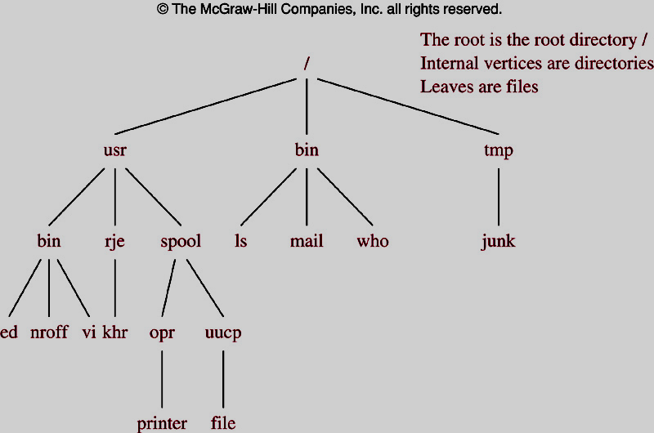
Some Tree Models
A Computer File System

Slide 12
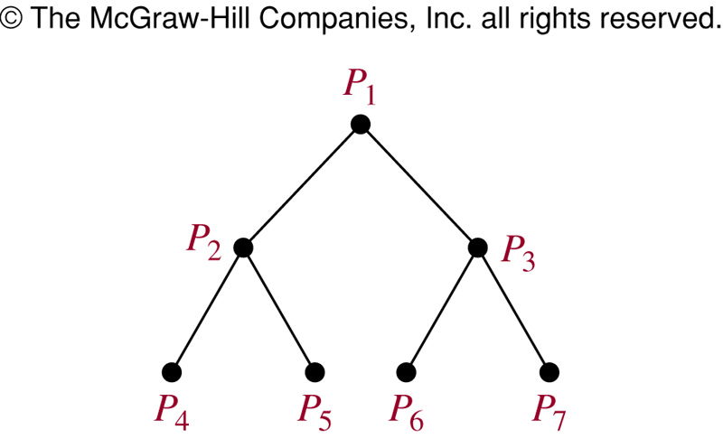
Some Tree Models
A Tree-connected Network of seven Processors

Slide 13

Properties of Trees
Using Mathematic Induction.
Let nE be number of edges.
P(n): If the tree T having n vertices then nE=n-1
Basic step:
P(1): n=1, tree has the root node only → nE= 0 = n-1 → P(1) true
Induction step:
Suppose that P(k) is true for all k>=1, ie nE=k-1
Add a leaf vertex v to the tree T so that T having k+1 verteices still is a tree.
Let w be the parent of v.
Because T is connected and has no simple circuit → there is only one new edge between u and v → nE= (k-1)+1 = k .
→ P(k+1) true
Proved.

Slide 14
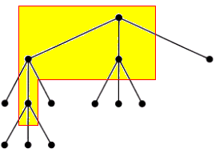
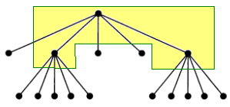
Introduction to Trees…
m=3
i=4
n= 3.4+1=13
m=5
i=3
n= 3.5+1=16

Slide 15
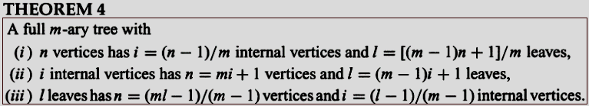
Introduction to Trees…
m=3
n=13
i=12/3= 4
l= [(3-1)13+1]/3=9
m=5
n=16
i= 15/5=3
l= (4.16+1)/5= 13

Slide 16
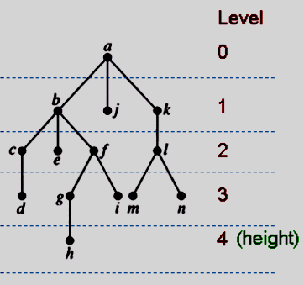
Introduction to Trees…
Level of a vertex: The length of the path from the root to this vertex.
Height of Tree: The maximum of levels of vertices = The length of the longest path from the root to any vertex.

Slide 17
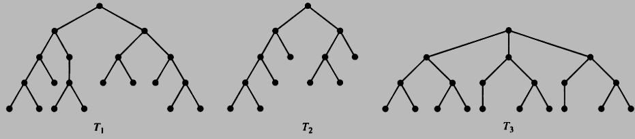
Introduction to Trees…
A m-ary tree is called balanced if all leaves are at levels h or h-1.
h=4
All leafs are at levels 3, 4
→ Balanced
h=4
All leafs are at levels 2,3, 4
→ Not Balanced
h=3
All leafs are at levels 3
→ Balanced

Slide 18
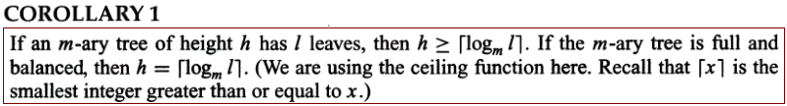
Introduction to Trees…
THEOREM 5: (Proof: page 692)
There are at most m^{h} leaves in an m-ary tree of height h.
Proof: page 693

Slide 19
10.2- Applications of Trees
Binary Search Trees
Decision Trees
Prefix Codes

Slide 20
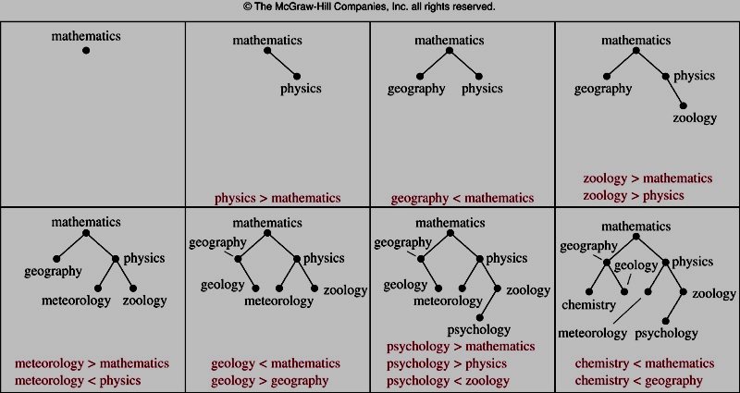
Constructing a Binary Search Tree
Construct a binary search tree for numbers: 23, 16, 43, 5, 9, 1, 6, 2, 33, 27.

Slide 21
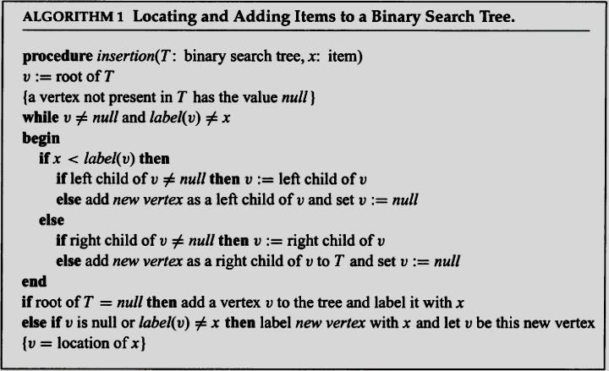
Algorithm for inserting an element to BST
Complexity: O(logn)
Proof: page 698

Slide 22
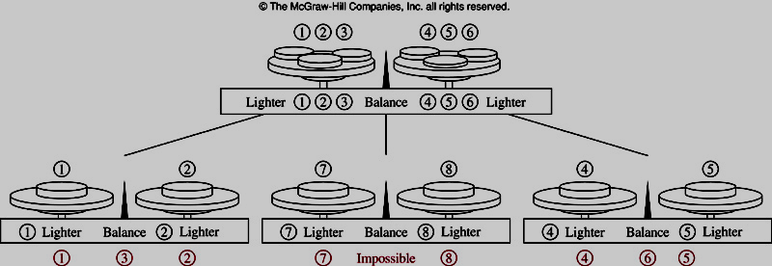
Decision Trees
The Counterfeit Coin Problem
Bài toán đồng tiền giả

Slide 23
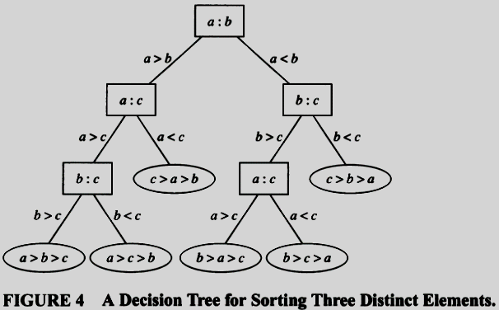
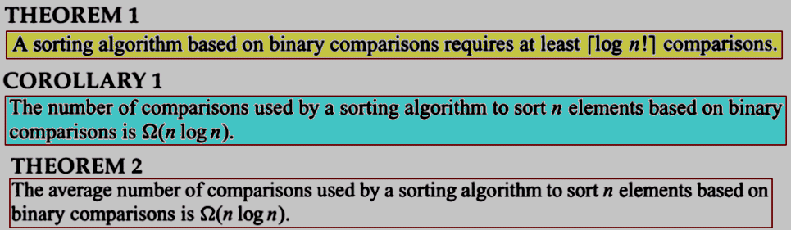
Decision Trees:
Sorting based on Binary Comparisons

Slide 24
Prefix Codes
Introduction to Prefix Codes
Huffman Coding Algorithm

Slide 25
Prefix Codes: Introduction
English word “sane” is stores 1 byte/character ➔ 4-byte memory block is needed (32 bits).
There are 26 characters → We can use 5 bit only to store a character ( 2⁵=32)
The word “sane” can be stored in 20 bits
May we can store this word in fewer bit?

Slide 26
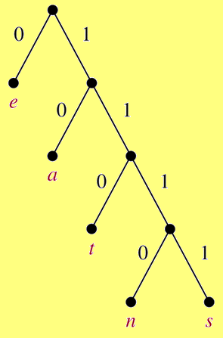
Prefix Codes: Introduction
Construct a binary tree with a prefix code.
“sane” will be store as
11111011100 ➔ 11 bits
11111011100 : s
11111011100 : a
11111011100 : n
11111011100 : e
Compression factor: 32/11 ~ 3

Slide 27
Prefix Codes: Huffman Coding Algorithm
Counting occurrences of characters in a text ➔ frequencies (probabilities) of each character.
Constructing a binary tree representing prefix codes of characters.
The set of binary codes representing each character.
Coding source text

Slide 28
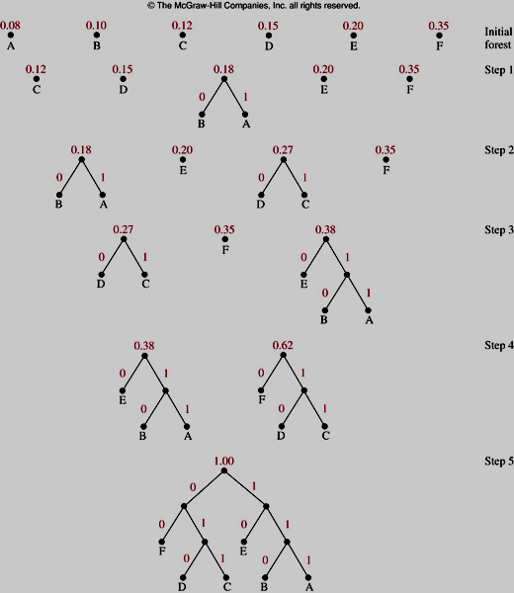
Prefix Codes: Huffman Coding Algorithm

Slide 29
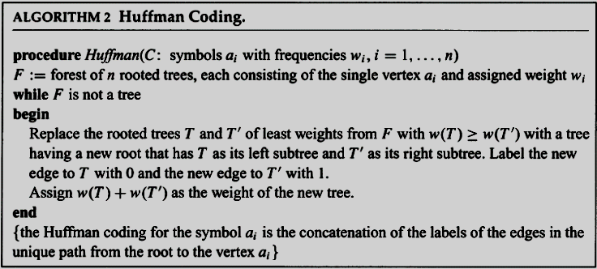
Prefix Codes: Huffman Coding Algorithm

Slide 30
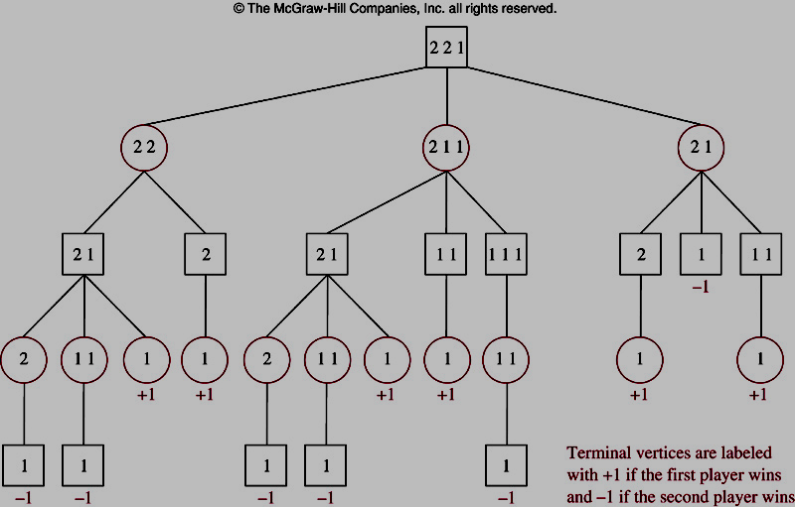
Game Trees: The Game Nim
There are some piles of stones ( ex: 2,2,1).
Two players will take turns picking stones from one pile.
The player picks the last stones is loser.
+
-
-
+
+
+

Slide 31
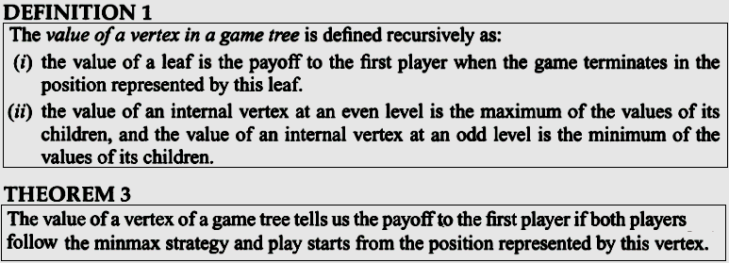
Game Trees…

Slide 32
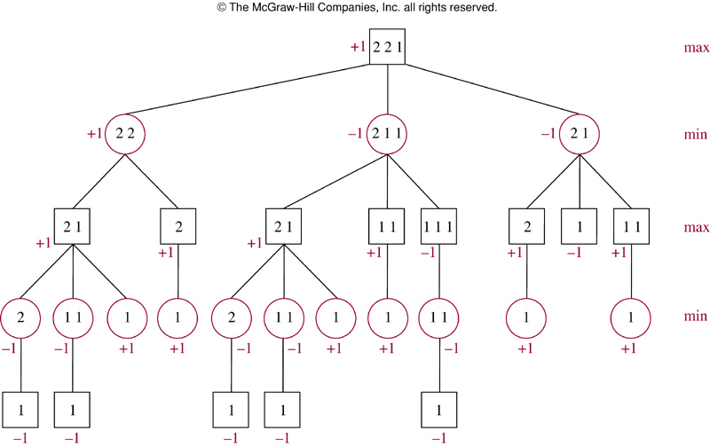

Game Trees…

Slide 33
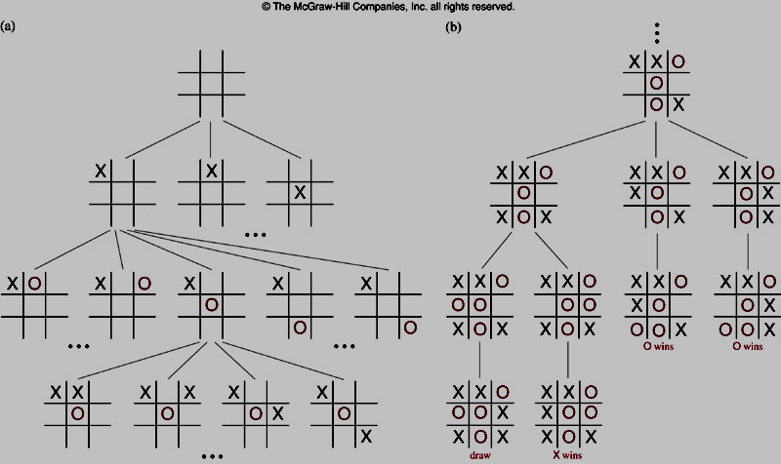
Game Trees : Tic-tac-toe – carô 3

Slide 34
Traversal Algorithms
At a time, a vertex is visited
Operations are done:
  Process the visited vertex, e.g. list it’s information
  Traversing recursively subtree.
Bases on orders of tasks, traversals are classified into:
  Preorder traversal. N L R
  Inorder traversal. L N R
  Postorder traversal. L R N

Slide 35
10.3- Tree Traversal
Traversal a tree: A way to visit all vertices of the rooted tree.
  Universal Address Systems
  Traversal Algorithms
  Infix, Prefix, and Postfix Notation

Slide 36
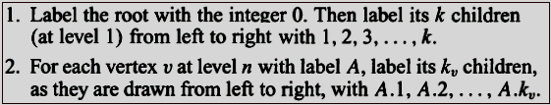
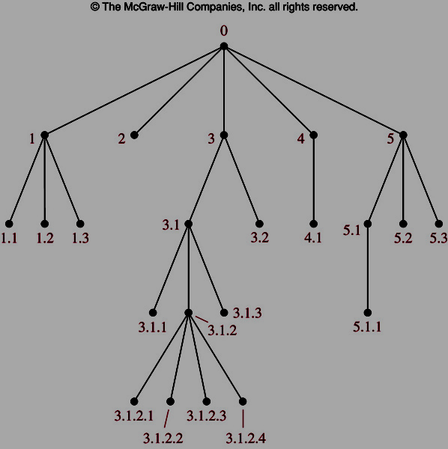
Universal Address Systems

Slide 37
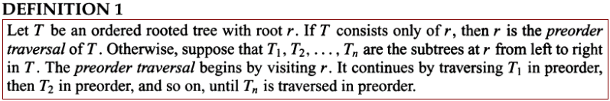
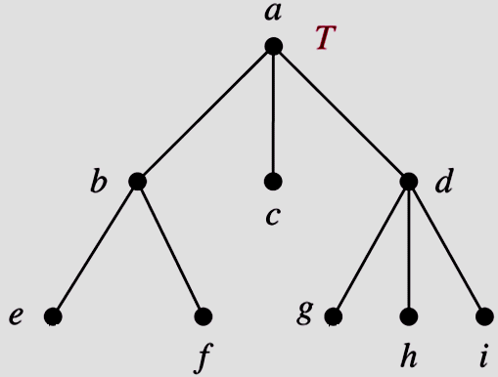
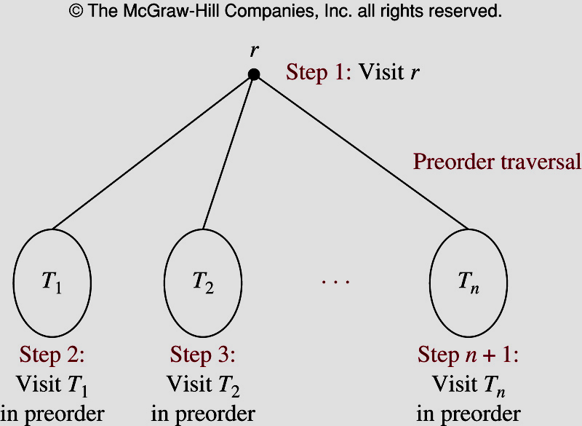
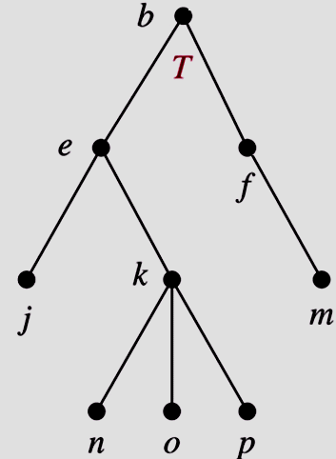
Preorder Traversal
a, b, e, f, c, d, g, h, i
?

Slide 38
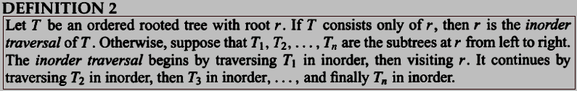
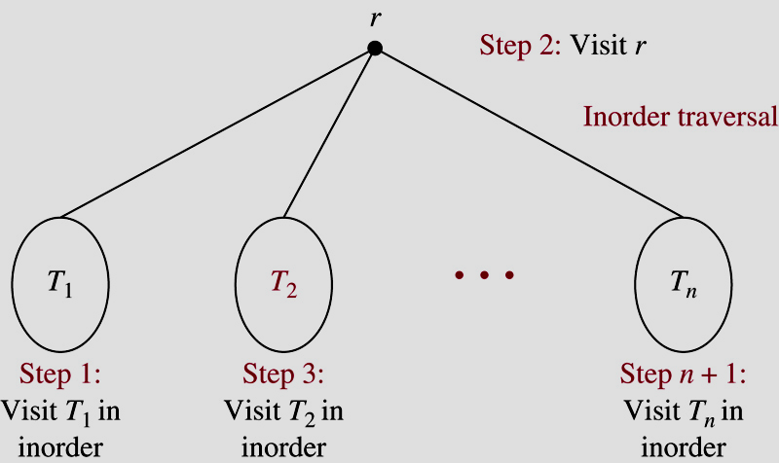
Inorder Traversal
e, b, f, a, c, g, d, h, i
?

Slide 39
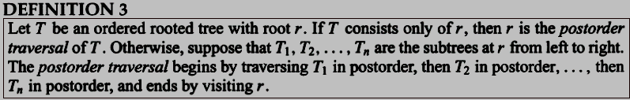
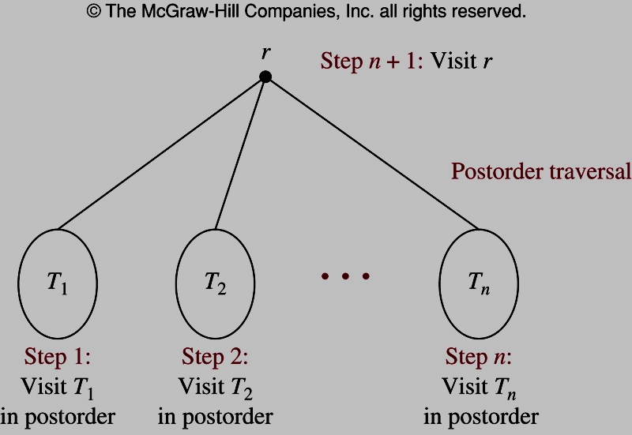
Postorder Traversal
e, f, b, c, g, h, i, d, a
?

Slide 40
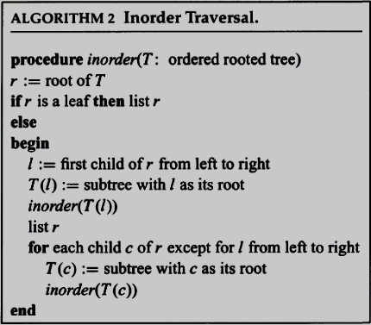
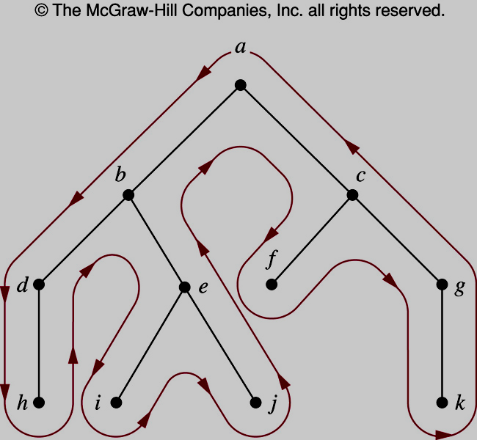
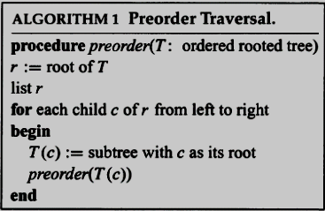
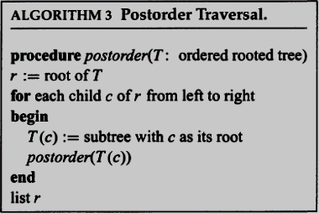
Traverse Algorithms

Slide 41
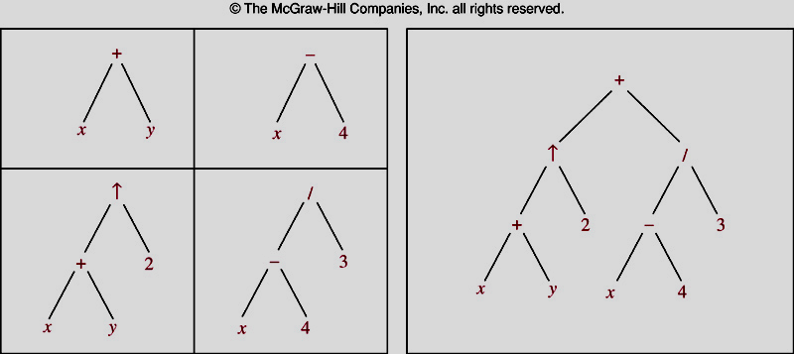
Infix, Prefix, and Postfix Notation
Expression Trees

Slide 42
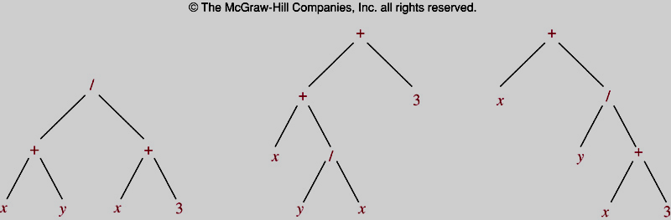
Infix, Prefix, and Postfix Notation
Expression Trees

Slide 43
Infix, Prefix, and Postfix Notation
Infix form (dạng trung tố):
  operand_1 operator operand_2 x + y
Prefix form (tiền tố-Polish notation):
  operator(operand_1,operand_2) + x y
Postfix form (hậu tố, reverse Polish form):
  (operand_1,operand_2)operator x y +
How to find prefix and postfix form from infix form?
  (1) Draw expression tree.
  (2) Using Preorder traverse → Prefix form
  Using Postorder traverse → Postfix form

Slide 44
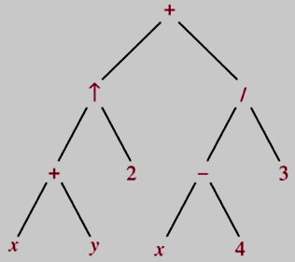

Infix, Prefix, and Postfix Notation
Infix form
Prefix form
Postfix form

Slide 45
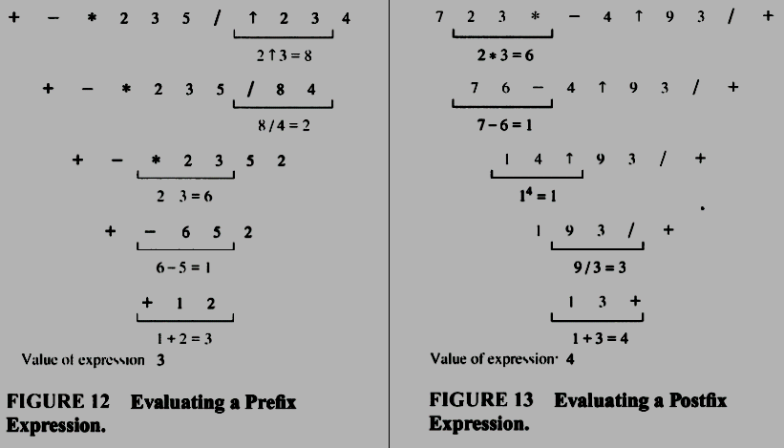
Infix, Prefix, and Postfix Notation

Slide 46
Summary
10.1- Introduction to Trees
10.2- Applications of Trees
10.3- Tree Traversal

Slide 47
Thanks

